Slide 1
Models for Understanding and Controlling Global Infectious Diseases HUMBIO 154D / HRP 204
Session 16
Jason Andrews
Jeremy Goldhaber-Fiebert
2020

Slide 2
Course Roadmap
First Models
SIR models with demography
Reproductive Number, Thresholds, Equilibria
Lab: Dynamic Models in R
Heterogeneous mixing and temporal modeling
Emerging infections: takeoff, growth, extinction
Lab: Emerging infections
Vectors, zoonoses, & environmental transmission
Stochastic dynamics
Spatial models, networks
Interventions and sensitivity analyses
Lab: Interventions and sensitivity analyses
Competition and evolutionary models
Within host evolution
Lab on Parameterization, calibration, and uncertainty
Health policy and economic evaluation models
Uses and abuses of models

Slide 3
REAL-WORLD RELEVANCE oF ECONOMIC EVALUATION AND POLICY ANALYSIS

Slide 4


Slide 5

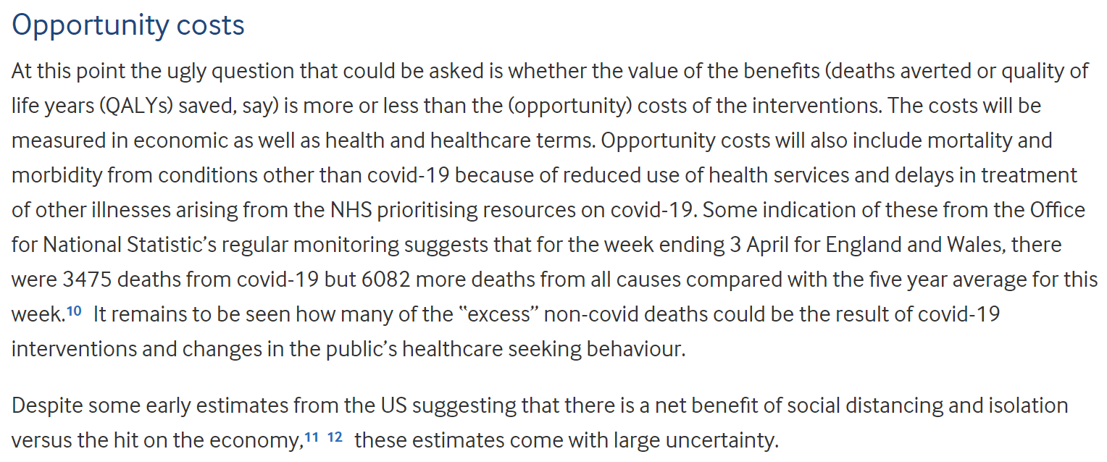

Slide 6

A debate over a decision argued about what the costs and benefits are and how we weight them
Deaths
Illness
Intervention Costs
GDP decline
…
Shelter-in-Place
Deaths
Illness
Intervention Costs
GDP decline
…
Reopen
Huge simplification of course. Need at least 2 alternatives for a decision but method can accommodate many alternatives

Slide 7
Practical Questions
For health policy evaluations, how is value defined and calculated?
How do we assess the value of alternative interventions or policies intended to control or eliminate an infectious disease epidemic in a given population?

Slide 8
Learning Objectives
Define Value and contrast it with assessments of cost-minimization and health-maximization
Define a decision problem in terms of alternatives and outcomes
Characterize interventions on the cost-effectiveness plane
Identify the areas of the cost-effectiveness plane where incremental analysis is required
Define the incremental cost-effectiveness ratio and when it connotes higher (lower) value
Know to ALWAYS avoid using average cost-effectiveness ratios
Become familiar with dominance to identify the cost-effectiveness frontier (graphical and tabular)
Consider how total costs and effects are streams of outcomes over a long time horizon
Become familiar with equations that include discounting
Become familiar with Quality-Adjusted Life Expectancy and Life Years (QALYs)
Connect computation of these streams and our simulation models and justify why we would use models to do this
Examine an applied example (TB and MDR-TB) which illustrates a cost-effectiveness using a dynamic transmission model
Consider advanced topic 1: How do we consider and report uncertainty in a CEA
Consider advanced topic 2: CEA with open populations vs. single cohorts

Slide 9
What is value?

Slide 10
Value ≠ Large Health Improvements

Slide 11
Value ≠ Low Prices

Slide 12
We assess Value, weighing both costs and effects, relative to available alternatives

Slide 13
How do we weigh the costs and effects of each intervention? And know when theY provide sufficient value?

Slide 14
Cost-effectiveness analysis: Simple technique to account for both effectiveness and costs

Slide 15
Accounting for Value
Spend more, get less
Spend more, get more
Negative
0
Positive
Change in costs
Spend less, get less
Spend less, get more
Negative
0
Positive
Gain in effectiveness
(health benefit)
Notes:
THIS SLIDE IS A BUILD
First two clicks bring up the axes (which you can explain).
Each click after that lights up a different quadrant in the space.

Slide 16
Accounting for Value
Spend more, get less
Spend more, get more
But is it worth it?
Negative
0
Positive
Change in costs
Spend less, get less
Spend less, get more
Negative
0
Positive
Gain in effectiveness
(health benefit)
Notes:
THIS SLIDE IS A BUILD
First two clicks bring up the axes (which you can explain).
Each click after that lights up a different quadrant in the space.

Slide 17
Accounting for Value
Less cost-effective
Spend more, get more
Change in costs
More cost- effective
Gain in health benefit
Notes:
THIS SLIDE IS ANIMATED; the “Spend more, get more” disappears after the slide opens.
Explain that we’d rather be in the lower right area… lots of gain in health benefit for little cost.
Note that at some point, it makes more sense not to cover an intervention, and to spend the money on a different intervention that generates more health benefit for the same spend.

Slide 18
Accounting for Value
Health benefit measured in QALYs
Value accounted by incremental cost-effectiveness ratio (ICER) (difference in costs divided by difference in benefits)
Greater ICER means less cost-effective
Dotted line represents our threshold willingness to pay
Less cost- effective
Change in costs
More cost- effective
Gain in health benefit
Notes:
How is health benefit measured? QALYs: account for changes in both length and quality of life.
The CER offers a single number that expresses whether an intervention is relatively more or less cost effective.
Explain that bigger CERs mean the intervention is cost effective, and explain that the CER is the slope.

Slide 19
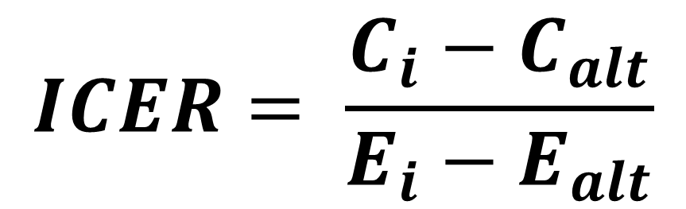
Incremental Cost-Effectiveness Ratio (ICER): How to compare two strategies in CEA
Numerator: Difference between costs of the intervention (strategy) and costs of the alternative under study
Denominator: Difference between health outcomes (effectiveness) of the intervention and health outcomes of the alternative
Incremental resources required by the intervention
Incremental health effects gained with the intervention
$$ICER= \frac{C_{i}−C_{alt}}{E_{i}−E_{alt}}$$

Slide 20
The Correct Cost-Effectiveness Ratio is NOT:
C_{i}
C_{alt}
or
E_{i}
E_{alt}
These represent the AVERAGE cost-effectiveness ratio, not the INCREMENTAL cost-effectiveness ratio
They should never be used

Slide 21
Incremental Analysis: Overview
Cost-effectiveness ratio always between two relevant alternatives
When there are multiple alternatives, we
rank order by ascending costs
compute incremental effects, costs
remove dominated alternatives
compute ratios relative to the next best, non-dominated alternative
The following slides detail this process

Slide 22
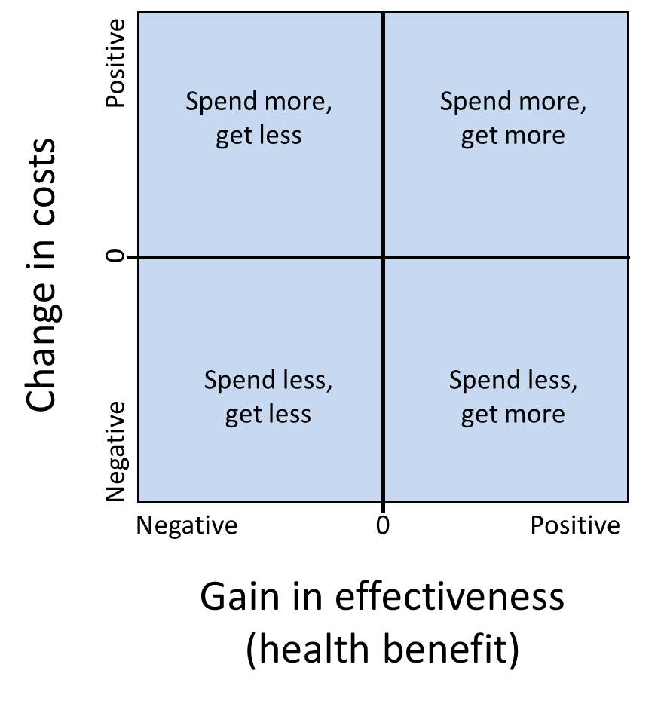
Dominance and Extended Dominance: Eliminate Dominated Alternatives
(Strict) dominance: One intervention more effective and less costly than an alternative
Extended dominance: More expensive intervention has a lower cost-effectiveness ratio than the lower-cost option. Alternatively, one intervention is strictly dominated by a linear combination of two other interventions.
Rational decision maker will not choose an option that is dominated by another, whether under strict or extended dominance

Slide 23
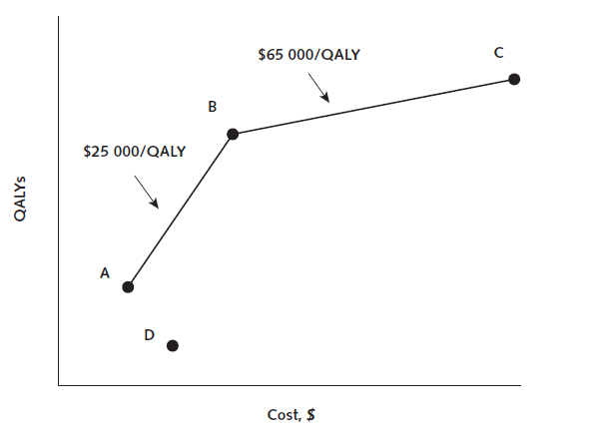
Strict dominance
Owens DK et al Annals of Internal Medicine 2011; 154: 174-180

Slide 24
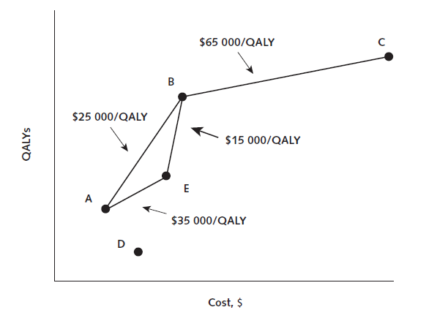
Extended dominance
Owens DK et al Annals of Internal Medicine 2011; 154: 174-180

Slide 25
Start with our strategies and their costs and effects in a table like this…
Strategy | Costs | QALYs | Incremental Costs | Incremental QALYs | ICER
A | 10,000 | 1.00
B | 35,000 | 2.00
C | 51,250 | 2.25
D | 20,000 | 0.50
E | 27,500 | 1.50
First, sort strategies in ascending order of costs like this…
Strategy | Costs | QALYs | Incremental Costs | Incremental QALYs | ICER
A | 10,000 | 1.00
D | 20,000 | 0.50
E | 27,500 | 1.50
B | 35,000 | 2.00
C | 51,250 | 2.25

Slide 26
Next, identify any strategies that cost more but are less effective (strictly dominated) …
Strategy | Costs | QALYs | Incremental Costs | Incremental QALYs | ICER
A | 10,000 | 1.00
D | 20,000 | 0.50
E | 27,500 | 1.50
B | 35,000 | 2.00
C | 51,250 | 2.25
Remove the dominated strategies and then compute the incremental costs and QALYs like this …
Strategy | Costs | QALYs | Incremental Costs | Incremental QALYs | ICER
A | 10,000 | 1.00
E | 27,500 | 1.50 | 17,500 | 0.50
B | 35,000 | 2.00 | 7,500 | 0.50
C | 51,250 | 2.25 | 16,250 | 0.25

Slide 27
Use the incremental costs and QALYs to compute incremental cost-effectiveness ratios …
Strategy | Costs | QALYs | Incremental Costs | Incremental QALYs | ICER
A | 10,000 | 1.00
E | 27,500 | 1.50 | 17,500 | 0.50 | 35,000
B | 35,000 | 2.00 | 7,500 | 0.50 | 15,000
C | 51,250 | 2.25 | 16,250 | 0.25 | 65,000
Search for patterns of extended dominance (rising and then falling incremental cost-effectiveness ratios), identifying strategies that are less costly but have a higher ICER as those dominated via extended dominance …
Strategy | Costs | QALYs | Incremental Costs | Incremental QALYs | ICER
A | 10,000 | 1.00
E | 27,500 | 1.50 | 17,500 | 0.50 | 35,000
B | 35,000 | 2.00 | 7,500 | 0.50 | 15,000
C | 51,250 | 2.25 | 16,250 | 0.25 | 65,000

Slide 28
Finally, remove the extended dominated strategies and recompute the incremental costs, QALYs, and incremental cost-effectiveness ratios, checking that no new dominated strategies exist … if none, then the process is done.
Strategy | Costs | QALYs | Incremental Costs | Incremental QALYs | ICER
A | 10,000 | 1.00
B | 35,000 | 2.00 | 25,000 | 1.00 | 25,000
C | 51,250 | 2.25 | 16,250 | 0.25 | 65,000
Strategy | Costs | QALYs | Incremental Costs | Incremental QALYs | ICER
A | 10,000 | 1.00
B | 35,000 | 2.00 | 25,000 | 1.00 | 25,000
C | 51,250 | 2.25 | 16,250 | 0.25 | 65,000

Slide 29
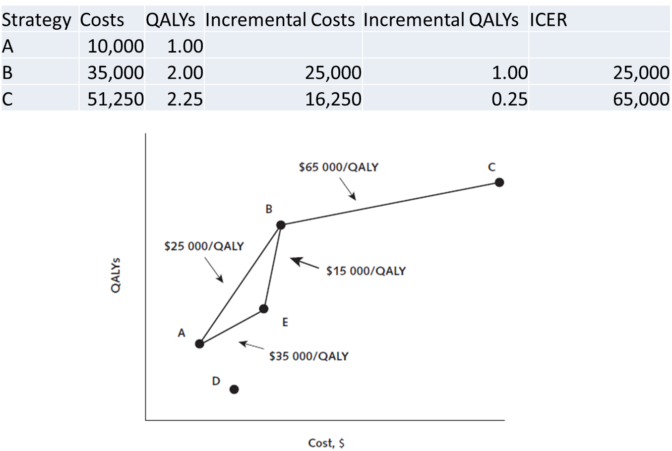
For the non-dominated strategy, we need a willingness-to-pay threshold to identify our preferred strategy

Slide 30
If wtp threshold <$25K/QALY gained, choose A If >= $25K but < $65K, choose B otherwise, choose C

Slide 31
Where do the numbers for the costs and effects for each strategy/intervention come from?

Slide 32
Model-based cost-effectiveness analyses: Because we are interested in long time horizons, many strategies, and quantifying uncertainty

Slide 33
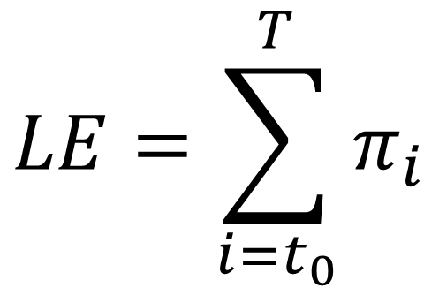
Modeling Outcomes: Life Expectancy
Life expectancy is average amount of time a person can expect to live given their current age (t₀) (and any other relevant status)
It can be computed as the sum of the fraction (π) of an initial cohort of people aged (t₀) at all future times (i)
$$LE=\sum_{i=t_{0}}^{T}{π_{i}}$$

Slide 34
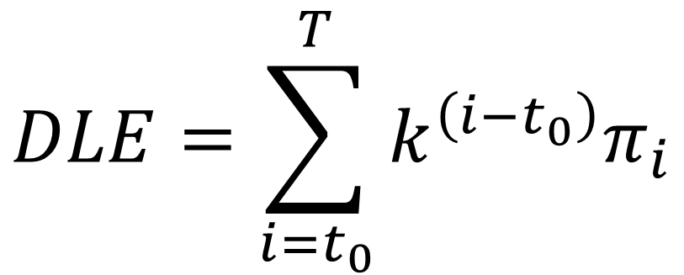
Modeling Outcomes: Discounted Life Expectancy
Discounted life expectancy is analogous to life expectancy except that future years are given lower weight.
Applying discount rate of 0 ≤ k ≤ 1 (think of k as 1/[1+r] where 1+r might be 103% annually), discounted life expectancy at age t₀ is
$$DLE=\sum_{i=t_{0}}^{T}{k^{\left(i−t_{0}\right)}π_{i}}$$

Slide 35
Modeling Outcomes: Quality-Adjusted Life Years (QALYs)
QALYs analogous to life expectancy except that each year is given an average “quality weight” q_{i}, taking value between 0 and 1.
Value of 1 represents perfect health, 0 represents quality of life equivalent to death
$$QALE=\sum_{i=t_{0}}^{T}{q_{i}k^{\left(i−t_{0}\right)}π_{i}}$$

Slide 36
Calculating QALYS (ignoring discounting, k=0)
1
0.9
0.7
1.0
Quality of Life
0.3
0
Date
1/02
1/04
6/05
6/06
1/09
Life Years = 2.0 + 1.5 + 1.0 + 2.5 = 7.0 years
QALYs = (2.0)(1.0)+(1.5)(0.7)+(1.0)(0.3)+(2.5)(0.9) = 5.6 QALYs

Slide 37
A “Life Path” of health-related quality of life: Effect of intervention
QALYs = area under curve
1
ΔQALYs gained
Quality of Life
0
Duration of Life
T
T’

Slide 38
Model computations
Our models produce the prevalence in each health state at each time under each strategy so we can easily compute total discounted QALYs for each strategy
Similarly, if we know the costs of the interventions and the costs of living in each health state, we can compute total discounted costs for each strategy

Slide 39
Using a dynamic transmission model for cost-effectiveness analyses

Slide 40


Slide 41


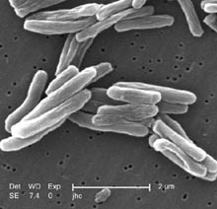
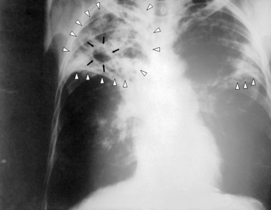
Background on Tuberculosis
Mycobacterium tuberculosis
Pulmonary TB
Drug-sensitive TB
Drug-resistant TB
4 cheap drugs
Standard course
6 months
$
5-6 not-cheap drugs
Individualized tx
2 years
$$$$$$$$$$$$

Slide 42
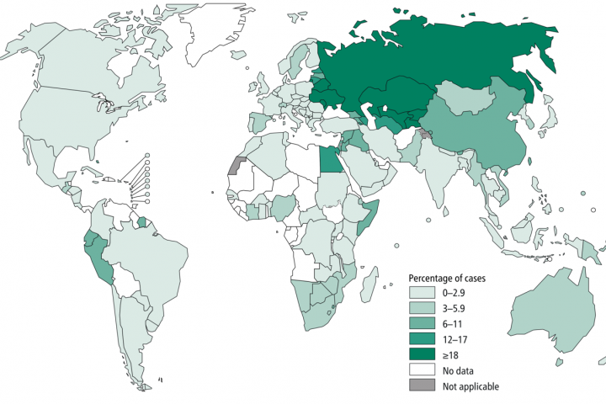
Multi-drug resistant TB worldwide
Percentage of MDR-TB among new cases. WHO 2018

Slide 43
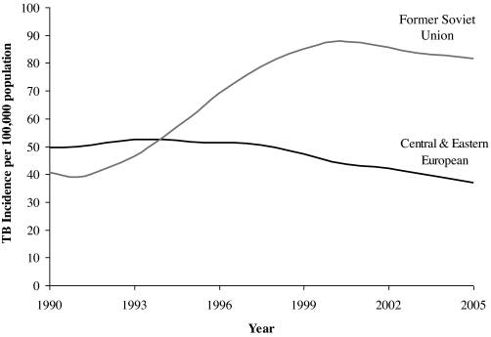
TB in the former Soviet Union (FSU)
After the fall of the Soviet Union, TB incidence rose sharply in the newly formed countries taking its place.
The proportion of MDR-TB among new and retreatment cases has also seen a stark increase.
Figure from Stuckler et al. 2008

Slide 44
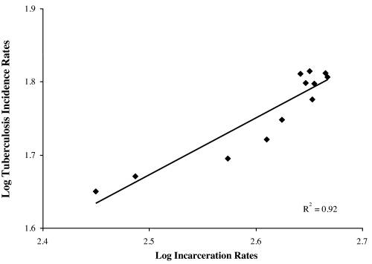
TB and incarcerated populations
Prisons can concentrate TB, acting as an “epidemiologic pump”
In 1999-2002 there were an estimated 1.4 Million people in custody in the FSU (Walmsley 2003)
As TB incidence and the fraction coming from prisons increased in the 1990s so too did the fraction that was MDR
Figure from Stuckler et al. 2008

Slide 45
TB diagnosis
Symptoms
Chest X-ray/Mass miniature radiography (MMR)
Sputum analysis
Direct smear microscopy (Ziehl-Neelsen staining) → “smear-positive” vs. “smear-negative”
Polymerase chain reaction (PCR)
Newer and more expensive technology
Can be used for screening, to determine drug resistance, or both

Slide 46
Research question
What is the relative effectiveness and cost-effectiveness of alternative strategies for screening and diagnosis of active TB available to prison health administrators in facilities where a substantial proportion of inmate TB cases are MDR-TB?

Slide 47
Decision Model

Slide 48
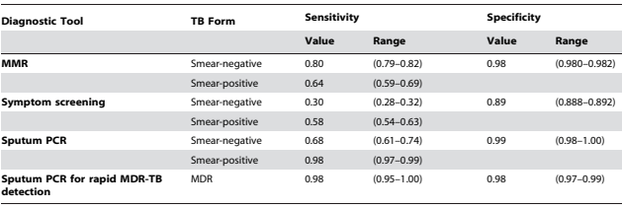
Symptom screening has the lowest sensitivity
MMR (x-ray) and PCR are 1 and 2 for detecting smear+ and smear- TB
Specificity is high except for symptom screening
How will this matter for the effectiveness of each strategy?

Slide 49
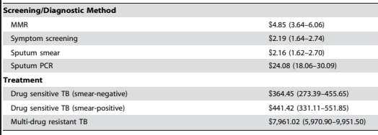
Symptom screening is cheapest
PCR is the most expensive
DS treatment is 1/20 the cost of MDR treatment
How will more sensitive strategies’ costs depend on this? How about more specific strategies?
What will happen for the costs of strategies that can differentiate MDR-TB?

Slide 50
Modeling framework and overview
A prison in the FSU (3 specific countries used in paper)
Stable prison population of 1,000 with density-dependent homogenous mixing.
1/3 of population leaves every year with equal probability from all health states; replaced by the same # of new inmates
Those entering the prison each year reflect the epidemiology of general population in FSU and sensitivity of initial MMR screen

Slide 51
Complicated SEIR model

Slide 52
DS-TB
MDR-TB

Slide 53
Active disease

Slide 54
Smear-positive

Slide 55
Treated and isolated*

Slide 56
Resistance acquired on treatment

Slide 57
Inappropriately treated (unrecognized) MDR-TB

Slide 58
Recognized appropriately treated MDR-TB

Slide 59
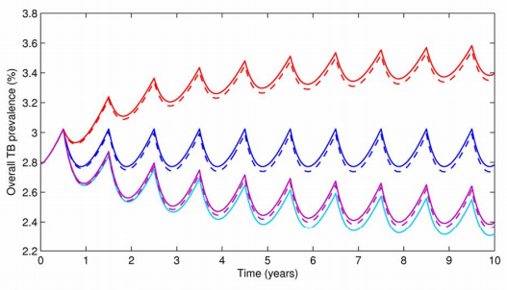
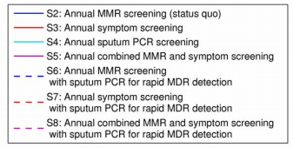
Symptom screening is less effective on TB prevalence than status quo; PCR or combo symptom screening/MMR more effective; Adding PCR for MDR testing only has little effect on TB prevalence

Slide 60
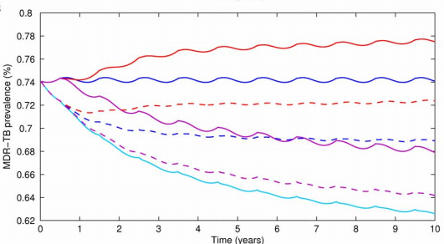
For MDR prevalence (~30% of overall cases in status quo), effectiveness story is very different

Slide 61
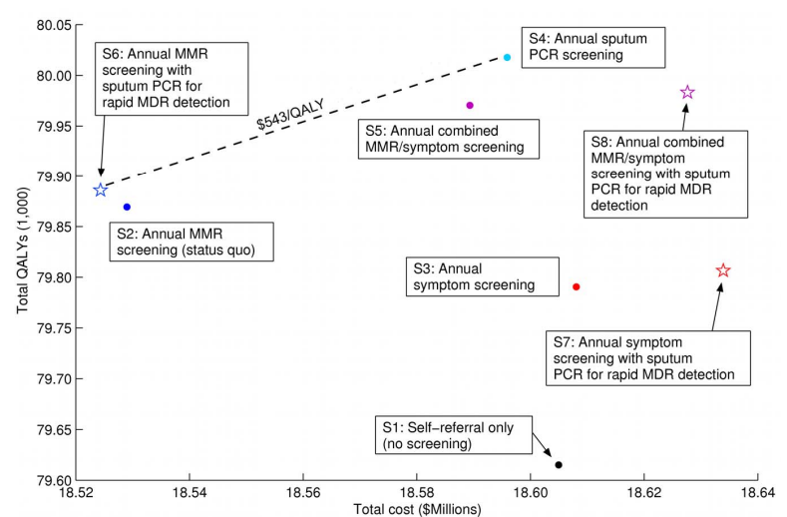
Cost-effectiveness plane and frontier. What strategy should we choose?

Slide 62
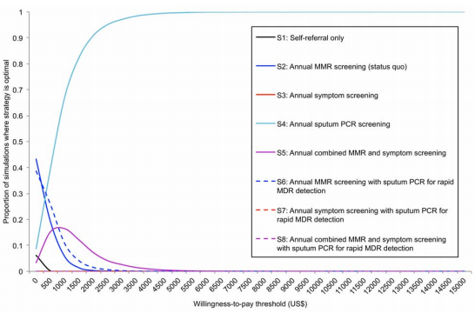
Advanced topic: Which strategy is most likely to be the cost-effective strategy?

Slide 63
Advanced topic: Special considerations when Using a dynamic transmission model for cost-effectiveness analyses (cohorts vs. population models)

Slide 64
For comparison: CEA with Cohort (Closed) Models with no Transmission
Starting time t=0: Cohort (often a birth cohort) so everyone the same age
Without intervention, follow cohort over its remaining lifetime counting discounted QALYs and costs
With intervention: Count discounted lifetime QALYs and costs; starting intervention at time (t=t_{i}) has chance to alter these quantities
Only 1 relevant time horizon: cohort’s lifetime horizon

Slide 65
For comparison: CEA with Open Models (especially with Transmission)
Starting time t=0: Cohort (often a birth cohort) so everyone the same age
Without intervention, follow cohort over its remaining lifetime counting discounted QALYs and costs
However, with open population models, new cohorts enter at times after t=0. There is no single “lifetime” horizon for the population
So what are the appropriate horizon(s)?

Slide 66
Time Horizons for CEA with Open Models (especially with Transmission)
We introduce the notion of an “analytic horizon” in addition to a “lifetime horizon”
The analytic horizon (in general) is defined by the time over which the intervention(s) is directly relevant
Benefits for any person/cohort alive during the analytic horizon should be counted over their lifetime
Analytic Horizon (e.g., 20 years)
t=0
t=AH
During the analytic time horizon, QALYs and/or costs of those alive can change due to intervention(s) which means that the numbers of people surviving to the AH may be different and in different health states than w/o the intervention (e.g., more uninfected people alive because transmission was reduced). What should we do about these survivors in terms of taking a “lifetime horizon” for them?

Slide 67
Time Horizons for CEA with Open Models (especially with Transmission)
After “analytic horizon”, goal: count up the remaining QALYs & costs (discounted)
Ignore additional births (cohorts) entering the model for t>AH
Ignore additional transmission effects after t>AH
Need to ensure we not only discount back to from t>AH to t=AH but actually back to t=0
Analytic Horizon (e.g., 20 years)
t=0
t=AH
How would you implement this post-AH counting of QALYs and costs?
How would you assess whether the length of the AH matters for your ICER estimates?
If it matters, how would you address this (generally)?

Slide 68
Time Horizons for CEA with Open Models (especially with Transmission)
How would you implement this post-AH counting of QALYs and costs?
How would you assess whether the length of the AH matters for your ICER estimates?
If it matters, how would you address this (generally)?
How would you implement this post-AH counting of QALYs and costs?
Could run the model with births and transmission turned off
Could flow anyone alive at the end of the AH into simple Markov models
How would you assess whether the length of the AH matters for your ICER estimates?
Run analysis with different AH durations and see
Could probably theorize about it more, but I think harder to know for sure
If it matters, how would you address this (generally)?
This means that transmission even far in the future is having an effect. Probably implies that the relevance of the decision is actually longer. In any case, report the results for a range of AH durations.

Slide 69
Important Announcements

